Slide 1



Weekly Progress: Optimizing
Multilingual Chatbot Output
On Development of an on-Premise AI Product Recommendation Model Using Open-Source LLM
Atique Md Monir Ahammod Bin (248810) 07 May 2025
Department of Artificial Intelligence Convergence

Slide 2

Project Description
Project Title
Development of an on-Premise AI Product Recommendation Model Using Open-Source LLM
Company: Narosu Co. Ltd.
Project Description
The e-commerce market is becoming increasingly competitive, requiring advanced recommendation systems.
Large marketplaces use sophisticated AI models, but independent online store operators lack such solutions.
This project aims to develop an AI-powered product recommendation system tailored for self-managed online stores.
By analyzing customer preferences, the system will suggest products that align with their interests.
Project Objective
Develop an AI-based search and recommendation system that analyzes user input sentences and recommends the TOP 5 most relevant products based on semantic similarity.
Utilize Natural Language Processing (NLP) and vector search technology to provide a highly refined search experience.
Deploy in an on-premise environment to ensure data privacy and full control over the recommendation process.
1

Slide 3

Company Requirements
Selected Model and Vector Store:
Embedding Model: text-embedding-ada-002
Vector DB/Search: Qdrant
LLM Reasoning: Llama 3.1 8B instant
LangChain Framework for LLM
UI Framework: Gradio
API Architecture: Gradio + FastAPI
2

Slide 4

System Configuration (AI Model) Diagram
3

Slide 5
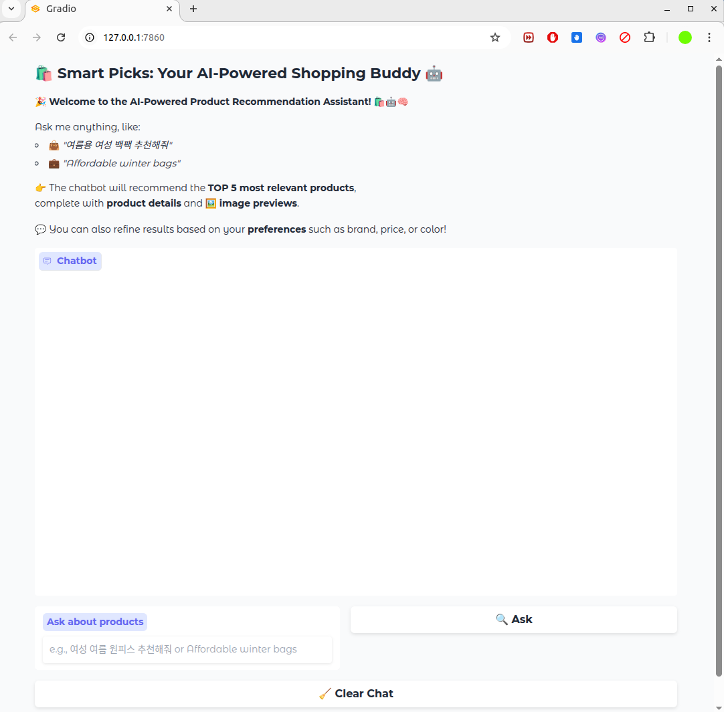
ChatBot User Interface (UI) Using Gradio
4

Slide 6
Project Schedule (Gantt Chart)
Phase | 2025
 | March |  |  |  | April |  |  |  | May |  |  |  | June
 | 1 | 2 | 3 | 4 | 1 | 2 | 3 | 4 | 1 | 2 | 3 | 4 | 1 | 2
Project Understanding and Data Collection
Data Analysis and Pre-processing
Model Selection and Training
System (RAG) Development
Chatbot Development
Testing and Deployment
5

Slide 7
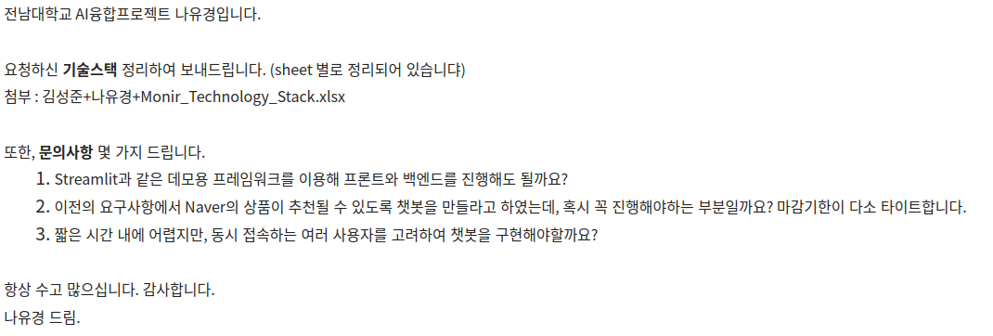
Previous Communication with Company
Asked some queries to the company:
6

Slide 8
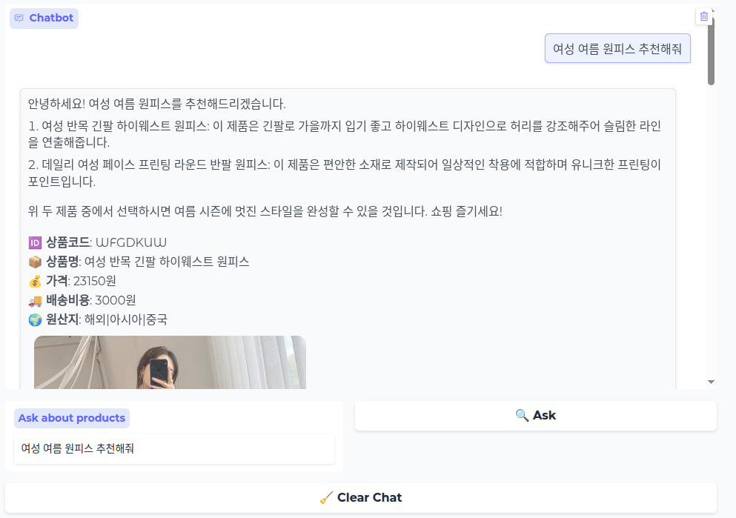
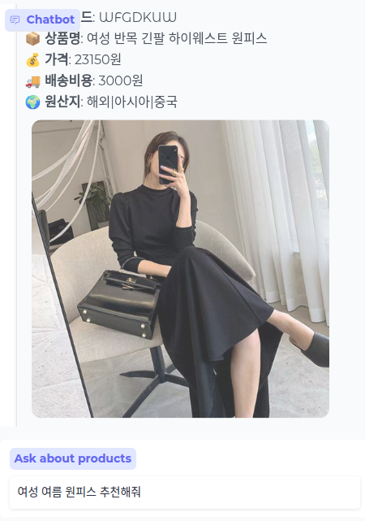
Testing the Chatbot with Korean Query
Recommendation in Korean is Okay
User Query in Korean: 여성 여름 원피스 추천해줘
7

Slide 9
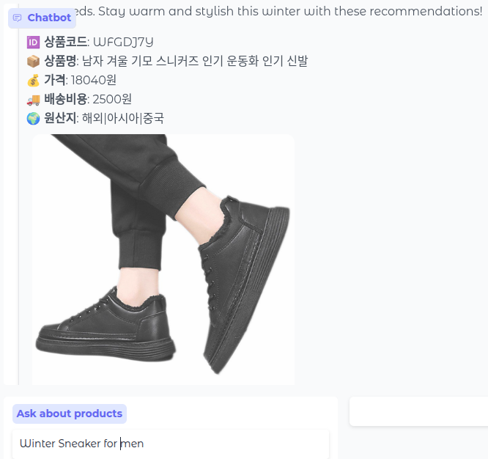
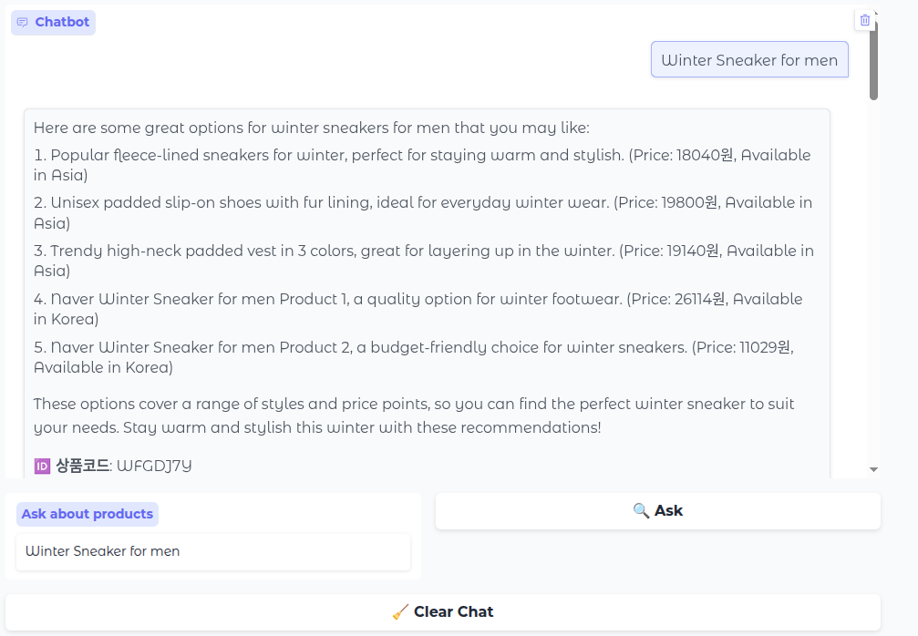
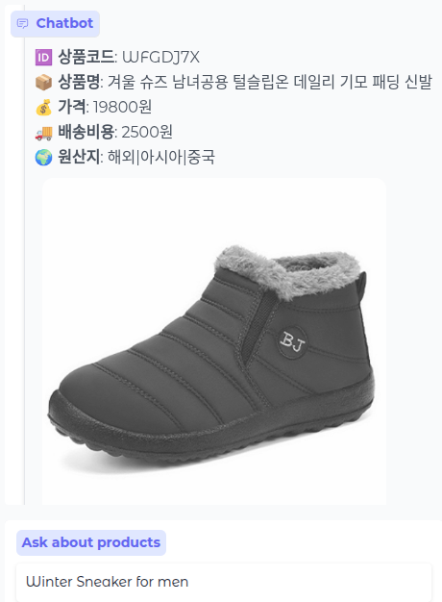
Testing the Chatbot with English Query
User Query in English: Winter Sneaker for men
1st Recommendation
2nd Recommendation
Need to translate the product details in English
8

Slide 10

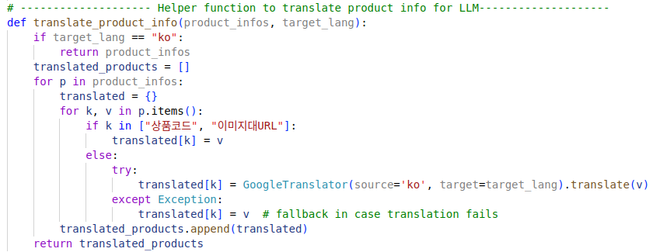
Code for Multilingual Chatbot Output
Import langdetect and deep_translator library.
A helper function to translate product details into user query language.
9

Slide 11
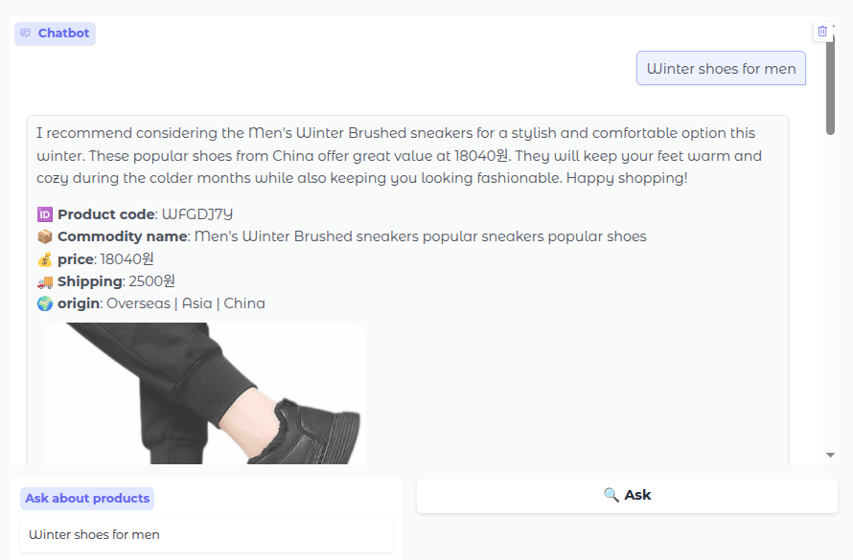
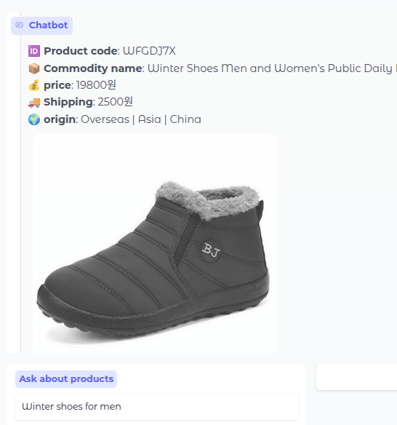
Multilingual Chatbot with English Query
User Query in English: Winter shoes for men
2nd Recommendation
1st Recommendation
Now the recommendation in
user query language
10

Slide 12
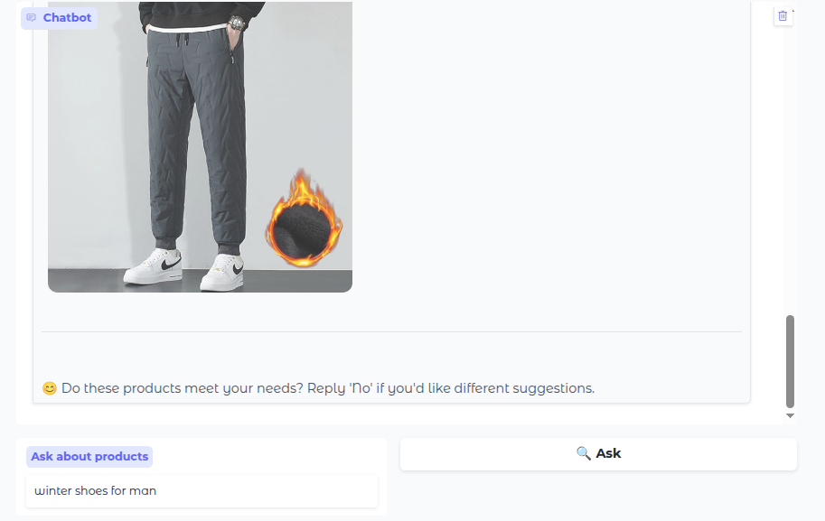
Alternative Recommendations
Asking for an alternative suggestion
11

Slide 13
Next Tasks To Do
Next Step
Support alternative suggestions
Upgrade the Chatbot UI for showing a user profile and login feature.
12

Slide 14
Thank You for Listening.
13

